Slide 1
Survey Site Analysis

Slide 2
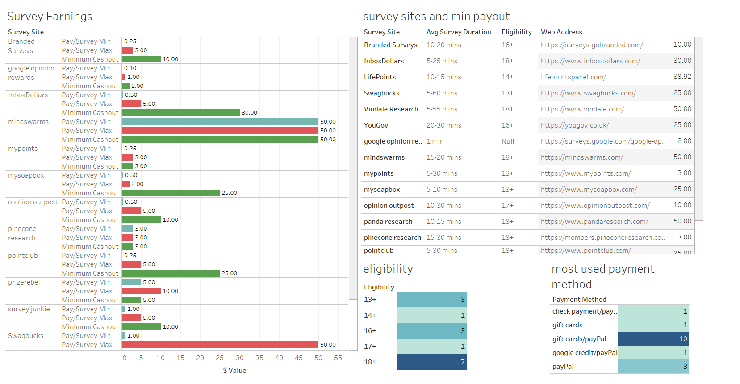

Slide 3
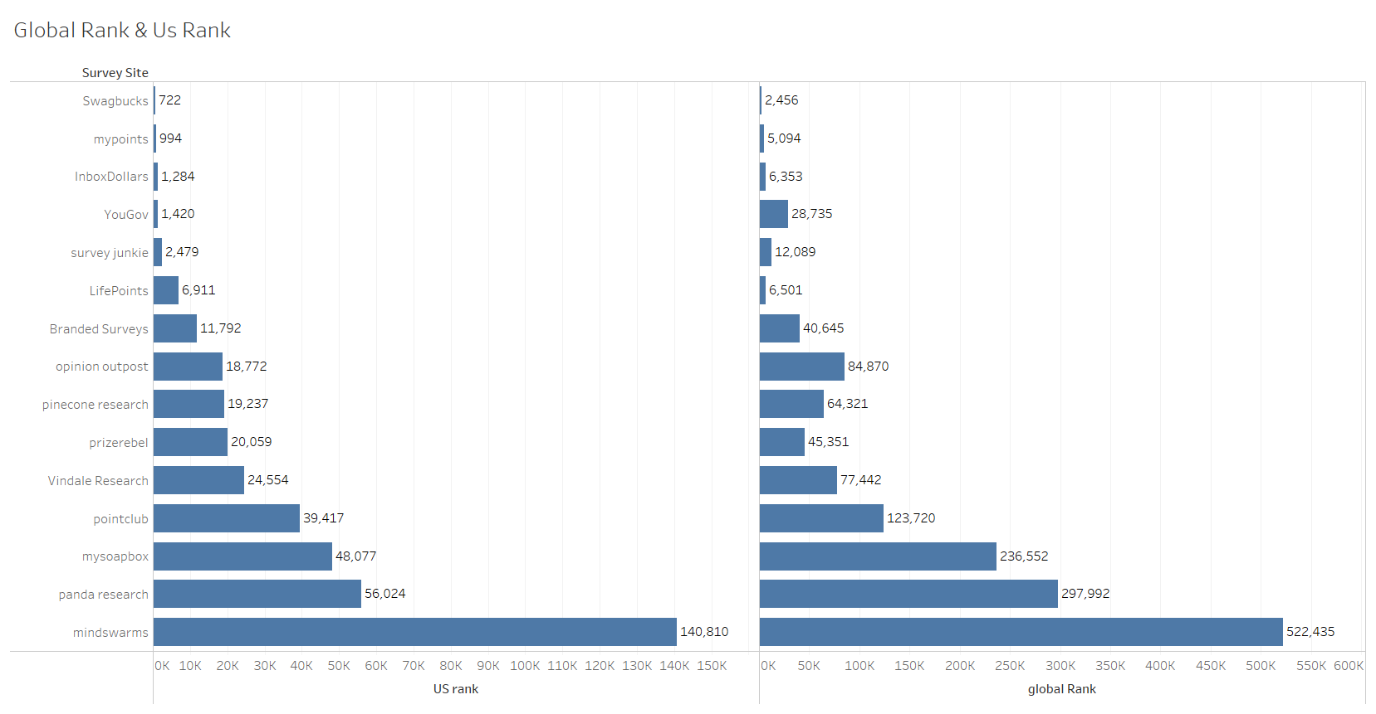
Site statistics gotten from similarweb.com

Slide 4
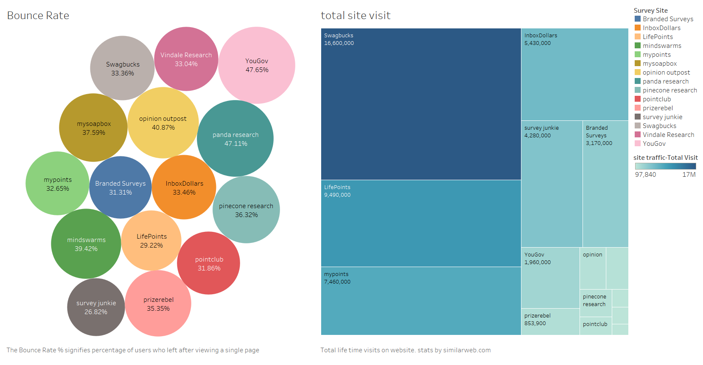
Site statistics gotten from similarweb.com

Slide 5
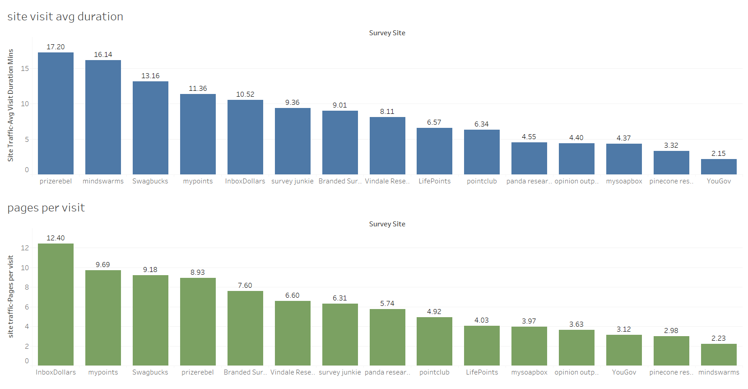
Site statistics gotten from similarweb.com

Slide 6
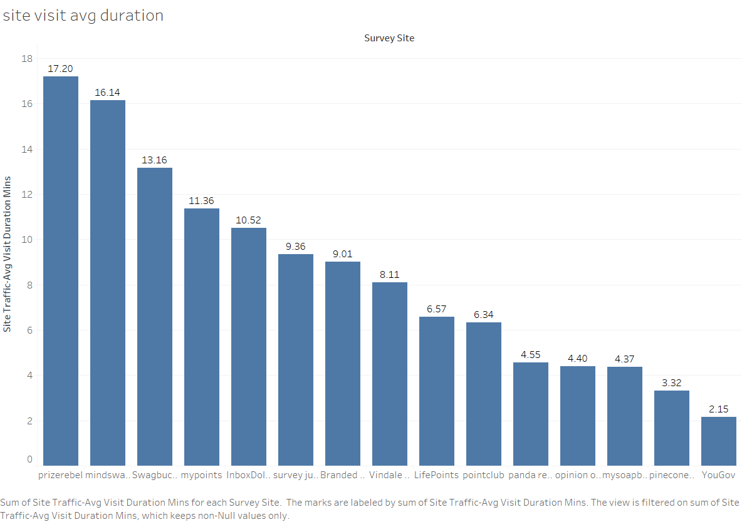
Site statistics gotten from similarweb.com

Slide 7
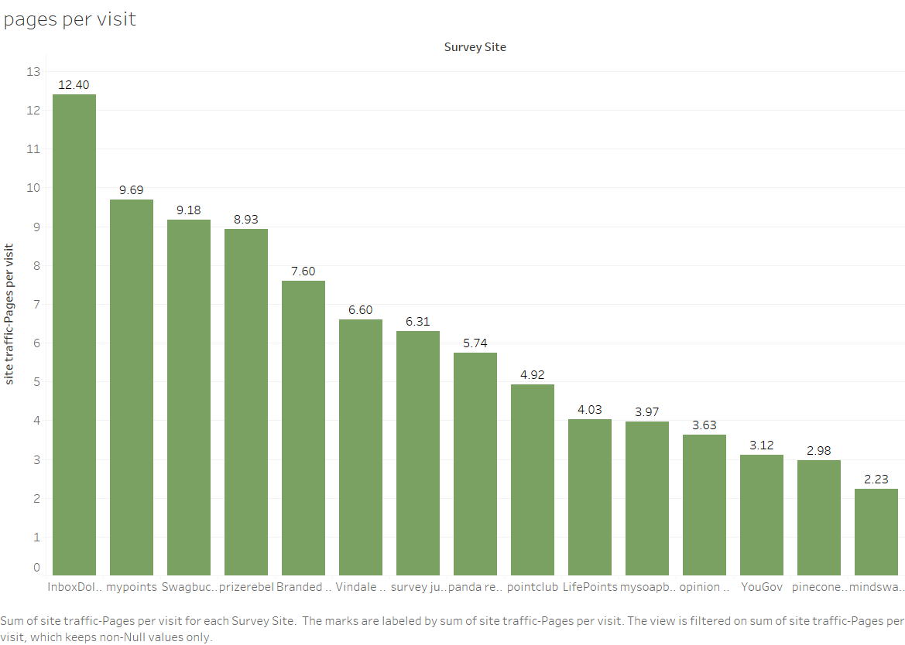
Site statistics gotten from similarweb.com

Slide 8
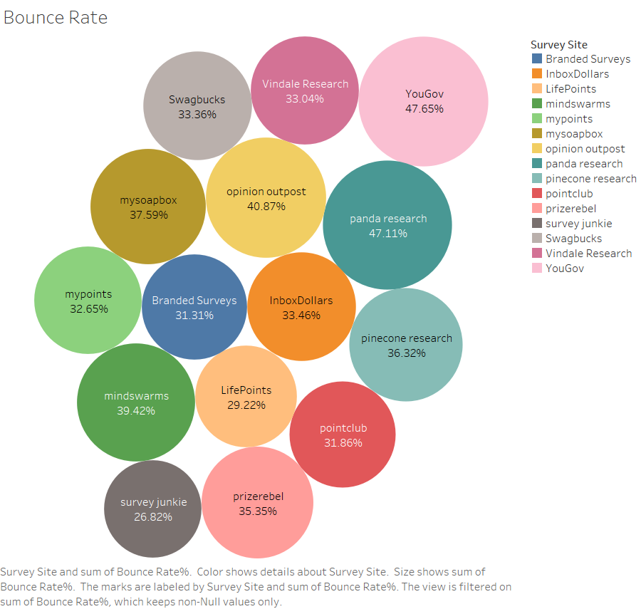
Site statistics gotten from similarweb.com

Slide 9
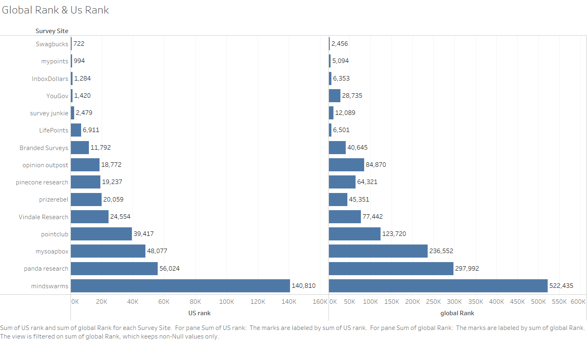
Site statistics gotten from similarweb.com

Slide 10
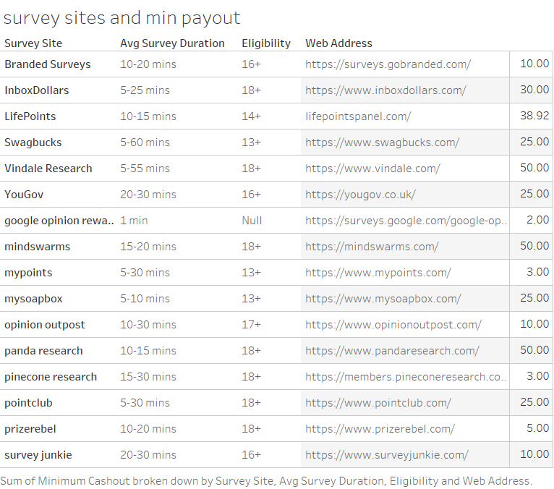

Slide 11
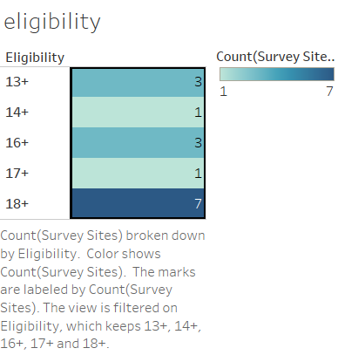

Slide 12
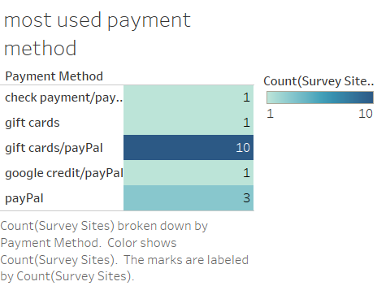

Slide 13
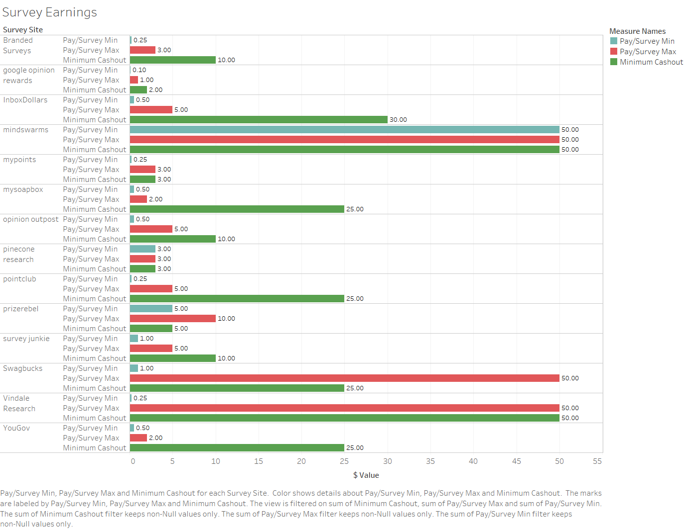

Slide 14
